Slide 1


FDIR Spacecraft fault protection system
Project 2
Final presentation
Architectural Design
Euro Team
Alauzet Pierre, Ahvenniemi Mikko,
Colin Julien, Starck Benoit
CS554 - Design for Software & Systems

Slide 2
Table of Contents
Context & business case
ATAM approach in the architecture building
Architectural decisions & design
Architectural analysis

Slide 3
1. Context & business cases
Business drivers, context
Business drivers, requirements

Slide 4
1. Business drivers - context
1. Context & business case
2. ATAM approach
3. Architectural design
4. Architectural analysis
Client : NASA
Users : Spaceship crew and flight control can manually control the system
The problem : Fault detection
Detected when monitored values are out-of-tolerance
The solution : Fault protection system (FDIR)
Act when the spacecraft is going through an error or a fault
FDIR is a layered system. If a lower layer cannot resolve an issue it’s forwarded to an upper layer. If the Issue cannot be resolved by the system. It’s escalated to manual control.
Automatic system

Slide 5
2. Business Drivers - requirements
1. Context & business case
2. ATAM approach
3. Architectural design
4. Architectural analysis
Clients global needs :
Guarantee the completion of any time critical activities of the spaceship
Keep the control of the spacecraft with safety, observability & commandability
Main qualities attributes :
Reliability : The system must be reliable in all operating conditions.
Availability : The system must not lock or stall when processing data. It must work asynchronously and must be available all the time.
Adaptability : FDIR has to be adaptable for manned and unmanned spacecraft.

Slide 6
2. ATAM approach in
the architecture building
ATAM assessment steps
Utility tree
Utility scenario
Overall architecture
Architectural approach

Slide 7
1. Atam assessment steps
1. Context & business case
2. ATAM approach
3. Architectural design
4. Architectural analysis

Slide 8
2. Utility tree
1. Context & business case
2. ATAM approach
3. Architectural design
4. Architectural analysis

Slide 9
3. Utility Scenarios
1. Context & business case
2. ATAM approach
3. Architectural design
4. Architectural analysis
Use case scenarios
No operation should be irreversible, and confirmation should be asked to user each time
The FDIR interface should provide several views with consistent conventions
Growth scenarios
A new sub-system must be able to be installed in to the FDIR in 1 person day of work
Exploratory scenarios
If the system load doubles from normal response time has to stay within 3 seconds.
The system has to be configurable to other spacecrafts in 1 person year of work

Slide 10
4. Overall architecture
1. Context & business case
2. ATAM approach
3. Architectural design
4. Architectural analysis
Control
Reporting system
FDIR control system
Localization
System call
Information displayer
Localization
FDIR fault analyzer
Information
retrieval
Values
Sorted values
FDIR fault detector
FDIR data storage system
Sorted values
Information
retrieval
Values
System recovery
Monitored systems
Legend :
Data flow
FDIR subsystems
Control flow
Spacecraft systems

Slide 11
4. Overall architecture (cont.)
1. Context & business case
2. ATAM approach
3. Architectural design
4. Architectural analysis
Manual FDIR
Automatical
Control
Information displayer
FDIR fault analyzer + control system
System control
Legend :
Subsystem
FDIR systems
Control
Localization
Device functions
Fault analyzer system
(5 layers)
Data storage system
Localization
Individual device
Report
Fault detector system
Values
System
recovery
Spacecraft
systems
Sorted values
Fault filtering system
Monitored system
FDIR fault
detector
Monitored value checker
Data flow
Information retrieval
Control flow
Values

Slide 12
5. Architectural approach
1. Context & business case
2. ATAM approach
3. Architectural design
4. Architectural analysis
Event driven architecture
Devices subscribe to sub-systems which in turn listen to events broadcasted by the devices.
Such events can be for example “announce value” event
Choice based on identified quality attributes
Enables asynchronous processing
High potential for resilience in case of failure
Load can be balanced efficiently between systems
Architectural approach follows logically from system architecture

Slide 13
3. Architectural
decisions & design
ADL choice and background
Critical architectural decisions
Architectural design propositions
Architecture

Slide 14

1. ADL investigation and choice
1. Context & business case
2. ATAM approach
3. Architectural design
4. Architectural analysis
We have chosen ACME !
Well known
Well documented
Good tools support
Complete and well-made software as an Eclipse plug-in
Free software available on every platforms
Developed in the same university as ATAM method – Carneggie Melon University
Provide a generic, extensible infrastructure for describing, representing, generating, and analyzing software architecture language description.
Provide descriptions that are easy to understand for everyone

Slide 15
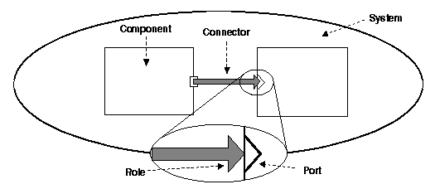
1. Acme reminder
1. Context & business case
2. ATAM approach
3. Architectural design
4. Architectural analysis
ACME describes a whole system thanks to
Library of 7 architectural elements
Components
Connectors
Systems
Ports
Roles
Representations
Representation maps
Architectural families
Tiered
Pipe & filters
Client & servers
Pub-Sub
Shared data
Three-tiered

Slide 16
2. Critical architectural decisions
1. Context & business case
2. ATAM approach
3. Architectural design
4. Architectural analysis
Architectural approach
Enables asynchronous processing
High potential for resilience in case of failure
Load can be balanced efficiently between systems
Utility tree
Availability
Reliability
Recoverability
Scenarios
Use case scenarios: user action should be done at any moment
Exploratory scenario: if a FDIR sub-system is crashing, FDIR should still work

Slide 17
3. Architectural design proposition (cont.)
1. Context & business case
2. ATAM approach
3. Architectural design
4. Architectural analysis
Architectural context
Centralized system
Distributed system
Producer
Broker
Consumer
Producer
Consumer

Slide 18
3. Architectural design proposition (cont.)
1. Context & business case
2. ATAM approach
3. Architectural design
4. Architectural analysis
Architectural types: available families in ACME Studio are
Tiered
Pipe & filters
Client & servers
Shared data
Three-tiered
Pub-Sub
Event based architecture where publishers and subscribers don’t know each others.
publishers notifies subscribers about news
subscribers are submitting their interest in particular news
This architectural style is :
space-decoupled : the event service links publishers and subscribers that don’t know each others
time-decoupled : publishers can send notifications while subscribers are not running and vice versa
synchronization-decoupled : concurrent activities can be performed by publishers and subscribers

Slide 19
3. Architectural design proposition (cont.)
1. Context & business case
2. ATAM approach
3. Architectural design
4. Architectural analysis
Pub-sub (Publish /Subscribes)
Content based
Subscription system based on a defined type of content
Subscribers declare the types of event they are interested to, by using filters
Possible to define combination of several types, but complex protocol
Topic based
Bundle communication peers, with methods to characterize & classify event content (divided by keys in a string shape).
Each topic is linked to an individual communication channel
Every topic is a static and primitive kind of event that a subscriber subscribes to

Slide 20
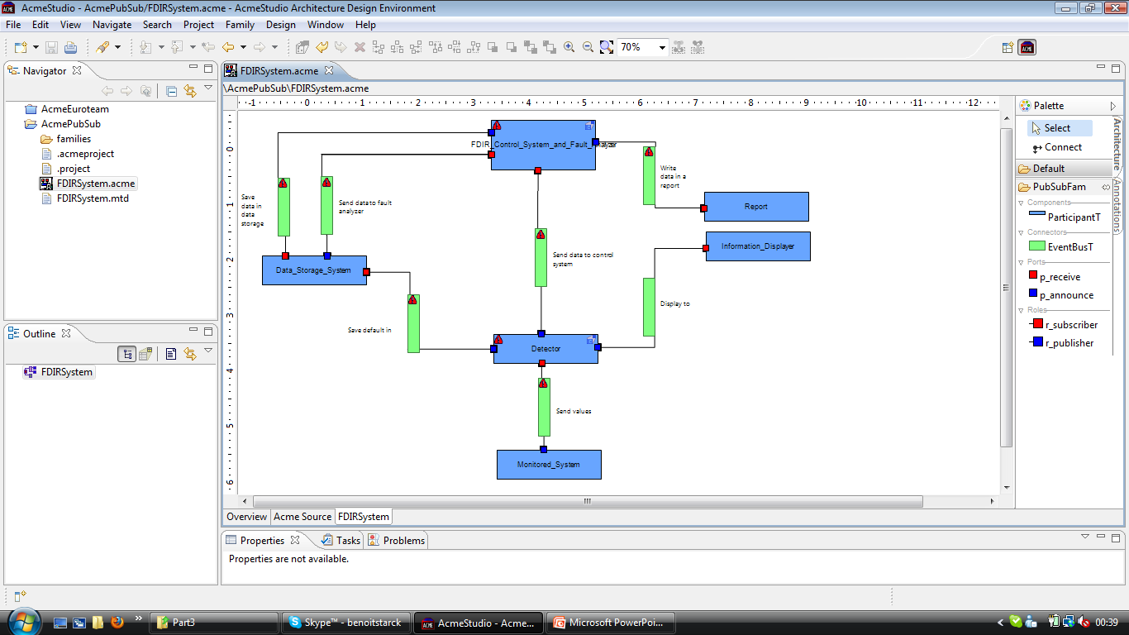
4. Architectural design using acme Studio
1. Context & business case
2. ATAM approach
3. Architectural design
4. Architectural analysis

Slide 21
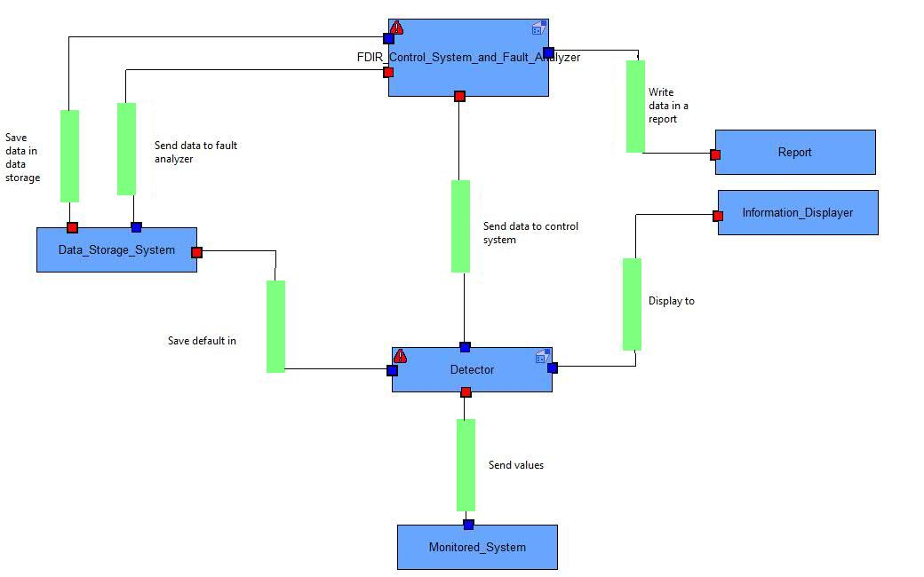
4. Architecture : FDIR SYSTEM representation
1. Context & business case
2. ATAM approach
3. Architectural design
4. Architectural analysis

Slide 22
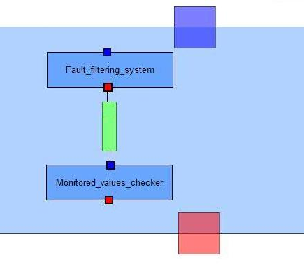
Architecture : Fault detector representation
1. Context & business case
2. ATAM approach
3. Architectural design
4. Architectural analysis

Slide 23
4. Architecture : FDIR SYSTEM representation
1. Context & business case
2. ATAM approach
3. Architectural design
4. Architectural analysis

Slide 24
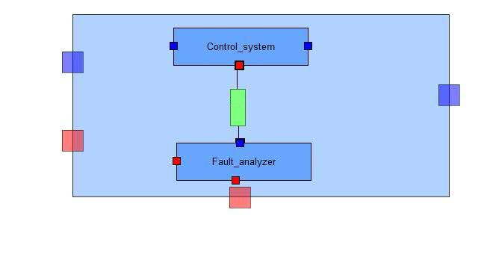
4. Architecture : Control system & fault analyzer
1. Context & business case
2. ATAM approach
3. Architectural design
4. Architectural analysis

Slide 25
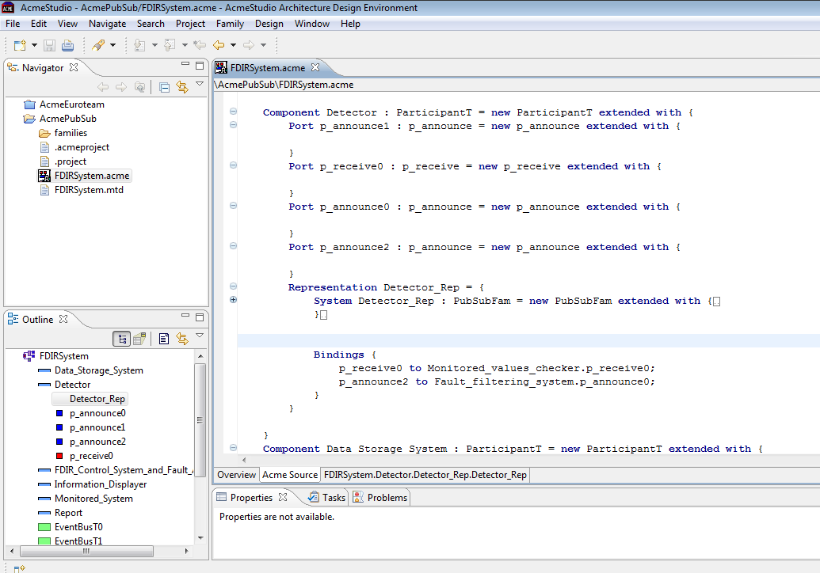
4. Architecture : code sample
1. Context & business case
2. ATAM approach
3. Architectural design
4. Architectural analysis

Slide 26
4. Architectural analysis
Requirements compliance
Architectural design strengths & weaknesses
Architectural type comparisons
Architectural approach analysis
Sensitivity points, risks, tradeoffs

Slide 27
1. FDIR & ADL Requirements compliance
1. Context & business case
2. ATAM approach
3. Architectural design
4. Architectural analysis
Thanks to Publish/Subscribe pattern
FDIR is a monitoring system involving several interaction between several components
Event-based architecture
Publish/Suscribe architectural style meet the need of asynchronous communication
The topic-based aspect allows us to focus on a limited number of kind of event
Control operation
Monitored values
Analysis results
Reports
Etc.
Publish and suscribe family is ready-to-be-used within ACME Studio tool

Slide 28
1. FDIR & ADL Requirements compliance (cont.)
1. Context & business case
2. ATAM approach
3. Architectural design
4. Architectural analysis
FDIR system organization
The layered fault analyzer and control system are better defined using a waterfall of publishers/subscribers
ACME studio allows us to clearly divide our architecture as we did with the overall model using representations
Utility tree
Availability & reliability are reached thanks to the loosed-coupling components in publish/subscribe architectural style
Recoverability is respected thanks to the independence of entities (publishers & subscribers) that can recover from failure while FDIR global system is still working

Slide 29
2. Architectural design strengths
1. Context & business case
2. ATAM approach
3. Architectural design
4. Architectural analysis
Loosely coupled
Publishers and Subscribers need not know of each other’s existence
They can also ignore system topology
Decoupling doesn’t work only location wise, but also temporally
Taking publishers down allows subscriber work through backlog for example
Scalable
Provides better scalability then client-server architecture in smaller installations
Parallel operation, message caching, tree-based or network-based routing

Slide 30
2. Architectural design weaknesses
1. Context & business case
2. ATAM approach
3. Architectural design
4. Architectural analysis
Disadvantages also stem from decoupling of publishers from subscribers
Stronger guarantees cannot be given that messages would always be delivered
Another problem can arise if publishers assume that subscribers are listening. For example if error messages are logged by the subscriber and the subscriber crashes message from the publishers will be lost
The technology scales poorly when systems become extensively large
Could manifest in instabilities in throughput, or slowdowns

Slide 31
2. Architectural design WEAKNESSES (CONT.)
1. Context & business case
2. ATAM approach
3. Architectural design
4. Architectural analysis
In-band message broadcasting can lead to security problems
Brokers might be fooled into sending notifications to the wrong client leading to potential DoS attacks
Brokers could be overloaded as well
Subscriber might be able to receive data that is is not authorized to receive.
An unauthorized publisher may be able to introduce incorrect or damaging messages into the system

Slide 32
3. Architectural type comparisons
1. Context & business case
2. ATAM approach
3. Architectural design
4. Architectural analysis
Architectural style | Scalability | Availability | Security | Maintenance
Pub-Sub | Good in the small | Good, because of decoupling | Potentially compromised because of decoupling | Possible complex due to distributed nature
Client-Server | Good in the large | Potentially compromised because of single point of failure | Strong because of central control | Usually simple because of centralized control

Slide 33
4. Architectural approach analysis
1. Context & business case
2. ATAM approach
3. Architectural design
4. Architectural analysis
Scenario | Scenario (Maintain operation despite sub-system failure)
Attribute | Availability
Environment | Normal operation
Stimulus | Sub-system failure
Response | Availability of rest of the system
Architectural decisions | Risk | Non-Risk | Sensitivity | Tradeoff
Pub-Sub architecture | R1 | NR1 | S1 | T1
Backup sub-systems | R2 | NR2 | S2
No backup data channel | R3 |  | S3 | T2
Distributed system | R4 |  | S4
Topic based messaging | R5 |  | S5
Separate data storage system | R6 | NR3 | S6 | T3
Reasoning
Pub-sub architecture achieves availability by providing possibility for additional subscribers (S3)
Publishers only send messages to the event bus and are not directly connected to subscribers
Backup system can be available reasonably fast considering (S2)

Slide 34
4. Architectural approach analysis
1. Context & business case
2. ATAM approach
3. Architectural design
4. Architectural analysis
Scenario | Scenario (Maintain operation despite sub-system failure)
Attribute | Availability
Environment | Normal operation
Stimulus | Sub-system failure
Response | Availability of rest of the system
Architectural decisions | Risk | Non-Risk | Sensitivity | Tradeoff
Pub-Sub architecture | R1 | NR1 | S1 | T1
Backup sub-systems | R2 | NR2 | S2
No backup data channel | R3 |  | S3 | T2
Reasoning
Pub-sub architecture achieves availability by providing possibility for additional subscribers (S3)
Publishers only send messages to the event bus and are not directly connected to subscribers
Backup system can be available reasonably fast considering (S2)

Slide 35
4. Architectural approach analysis
1. Context & business case
2. ATAM approach
3. Architectural design
4. Architectural analysis
Scenario | Scenario (The system and its parts have to be able to be tested through inspections, simulations and analyses)
Attribute | Testability
Environment | Development
Stimulus | FDIR cannot be fully tested before installation
Response | FDIR is tested with simulations and analyses before assembly
Architectural decisions | Risk | Non-Risk | Sensitivity | Tradeoff
Pub-Sub architecture | R1 | NR1 | S1 | T1
Distributed system | R4 |  | S4
Separate data storage system | R6 | NR3 | S6 | T3
Reasoning
Pub-sub architecture makes it possible to attach and detach publishers and subscribers easily facilitating testability(NR1)
The fact that distributed system approach is used also makes it easier to perform testing on the system
Separate data storage system makes it also possible to more easily test as the data is not stored in the nodes (T3)

Slide 36
4. Architectural approach analysis
1. Context & business case
2. ATAM approach
3. Architectural design
4. Architectural analysis
Scenario | Scenario (The system must use an asynchronous mode of operation)
Attribute | Availability
Environment | Normal operation
Stimulus | System sends data that needs to be processed while system is processing data
Response | Processing on new data is started instantaneously
Architectural decisions | Risk | Non-Risk | Sensitivity | Tradeoff
Pub-Sub architecture | R1 | NR1 | S1 | T1
Backup sub-systems | R2 | NR2 | S2
Reasoning
Pub-sub architecture helps to achieve availability in this case by providing possibility for loose coupling between subscribers and publishers.
Backup systems can be used to provide additional processing capability, which is also asynchronous.

Slide 37
5. Risks
1. Context & business case
2. ATAM approach
3. Architectural design
4. Architectural analysis
Risk | Description
R1 | Pub-Sub architecture contains the event bus. Availability may be compromised if the bus clogs down and messages won’t get through. This will happen If there is a swarm of messages that cannot be handled fast enough.
R2 | If backup system has inconsistent data with the actual system, availability of the system might be compromised. This will happen when messages in queue are not delivered to recipients.
R3 | There is only one data channel. If there is a malfunction in the channel, the availability of the system is compromised. This happens for example if the physical data cable breaks down.
R4 | The system uses a distributed structure. This can lead to problems with performance if the system becomes too large. The number of possible connections between nodes in the system increase exponentially as the nodes of the system increase linearly.
R5 | The system uses topic based messaging. This can lead to problems with performance if the topic channels are designed poorly. When too many nodes in the system receive the same messages it creates unnecessary processing burden.
R6 | The system uses a separate data storage system. This can lead to problems with availability if the system goes down. If the system goes down and the backup system is not working or there is non it means the system cannot function properly.

Slide 38
5. non-Risks
1. Context & business case
2. ATAM approach
3. Architectural design
4. Architectural analysis
Non-Risk | Description
NR1 | The system uses Pub-Sub architecture. It doesn’t matter if some subscriber or publisher goes down and the system can continue to function otherwise normally. This is due to the fact that Pub-Sub architecture is loosely coupled and publishers and subscribers are not directly aware of each other.
NR2 | The system employs back-up systems for critical parts. It’s reasonable that a back-up system can be operational within 1 minute. This is due to readiness of backup systems, which ensures fast startup.
NR3 | The system employs a separate data storage system. It’s reasonable to assume that there won’t be inconsistent data in the system. This is due to the fact that the data is stored in one place and the backup system is kept up to date.

Slide 39
5. Sensitivity points
1. Context & business case
2. ATAM approach
3. Architectural design
4. Architectural analysis
Sensitivity Point | Description
S1 | The latency for handling messages is sensitive to the ratio between publishers and subscribers. If there are too many publishers per subscriber latency will increase.
S2 | Response time of the backup system is sensitive to the readiness of backup system. Options are for example it can be turned off, turned on, or even turned on and actively synchronized
S3 | Performance of the system is sensitive to the bandwidth of the data channel.
S4 | The performance of the distributed system is sensitive to the number of nodes attached to it. Especially high node counts start to affect the performance as the number possible connections between nodes increases exponentially
S5 | The performance in topic based messaging is sensitive to the number of specialized topics. If there are only one or two topics. The messages have to be sent to every node taking toll on performance.
S6 | The performance of the system is sensitive to the performance of the data storage system. If the data cannot be sent out in timely manner the system performance will suffer. So the data storage system can become a bottleneck.

Slide 40
5. tradeoff points
1. Context & business case
2. ATAM approach
3. Architectural design
4. Architectural analysis
Tradeoff Point | Description
T1 | Pub-Sub architecture scales really well in smaller installations, but if the system becomes too large the large number of messages starts to clog down the system
T2 | Using one data channel is good for performance of the system, but on the other hand it makes to system possibly vulnerable in regards to availability if there is a malfunction in the data channel
T3 | Using centralized data storage is essentially a tradeoff between performance and availability. The data isn’t stored closest to the place of need and has to fetched from the system. Well secured data storage with backup guarantees however that data will always be available if some other system goes down.

Slide 41
Conclusion
General learning points and architectural results
Be able to justify architectural key decisions and propositions
Explain and represent an architecture using rules and tools
Analyze and criticize an architecture
Propose alternatives to given architecture
Provide the output of architectural analysis facilitate communicating the architectural design to stakeholders
Technical learning points
Refer to ATAM process
Use ADL methods
Manage ACME ADL and Acme Studio tool

Slide 42
FDIR Spacecraft fault protection system
Project 2
Final presentation
Architectural Design
Euro Team
Alauzet Pierre, Ahvenniemi Mikko,
Colin Julien, Starck Benoit
CS554 - Design for Software & Systems

Slide 43
references
[BCK98] L. Bass, P. Clements, R. Kazman, Software Architecture in Practice (2nd ed.), Addison-Wesley, 2003.
[Eas98] Steve Easterbrook, and et al., “Experiences Using Lightweight Formal Methods for Requirements Modeling,” IEEE Transactions on Software Engineering, Vol. 24, No. 1, January 1998.
[KKC00] R. Kazman, M. Klein, P. Clements, ATAM: A Method for Architecture Evaluation, CMU/SEI-2000-TR-004, Software Engineering Institute, Carnegie Mellon University, 2000.
[SG96] M. Shaw and D. Garlan, Software Architectures – Perspectives on an Emerging Discipline, Prentice Hall, 1996.
P. T. Eugster, P. A. Felber, R. Guerraoui and A. M. Kermarrec, The Many Faces of Publish/Subscribe, in ACM Computing Surveys, vol. 35, no. 2, June 2003, pp. 114-131

